Slide 1

IT Ticket Analysis
Tushar Gupta
January 17, 2025

Slide 2
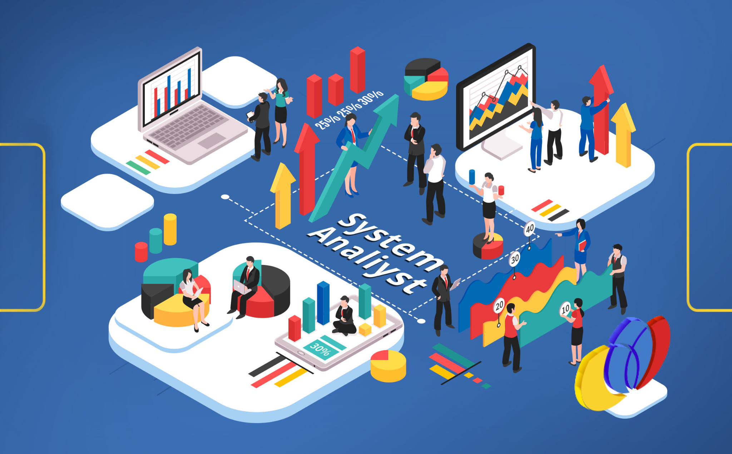
Introduction and Objectives
Introduction: This presentation delves into the analysis of IT ticket data to uncover patterns, assess performance metrics, and identify actionable insights to improve operational efficiency and agent effectiveness.
Objectives:
Analyze ticket resolution times, categories, and trends over time.
Evaluate IT agent performance and highlight areas requiring intervention.
Provide strategic recommendations to optimize IT operations

Slide 3

Data Overview
Datasets Analyzed:
Tickets Dataset: 10 attributes, including ticket categories, resolution times, priority levels, and severity.
IT Agents Dataset: 8 attributes covering agent details such as email addresses, birth years, and tickets handled.
Key Findings:
Total Tickets: 97,498
Average Daily Tickets: 53/day
Average Resolution Time: 4.5 days
Categorical Columns: 5 in Tickets Dataset, 1 in IT Agents Dataset.

Slide 4
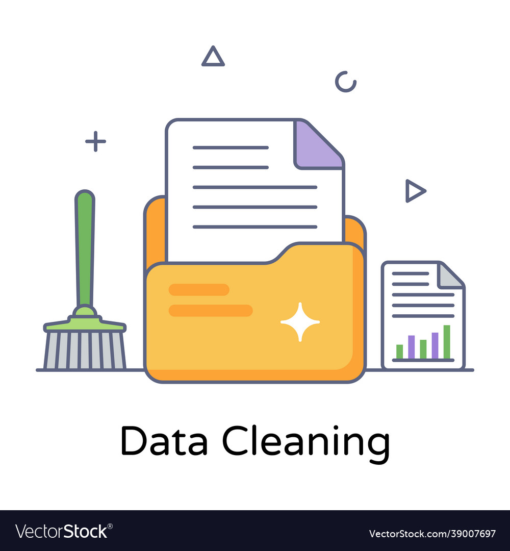
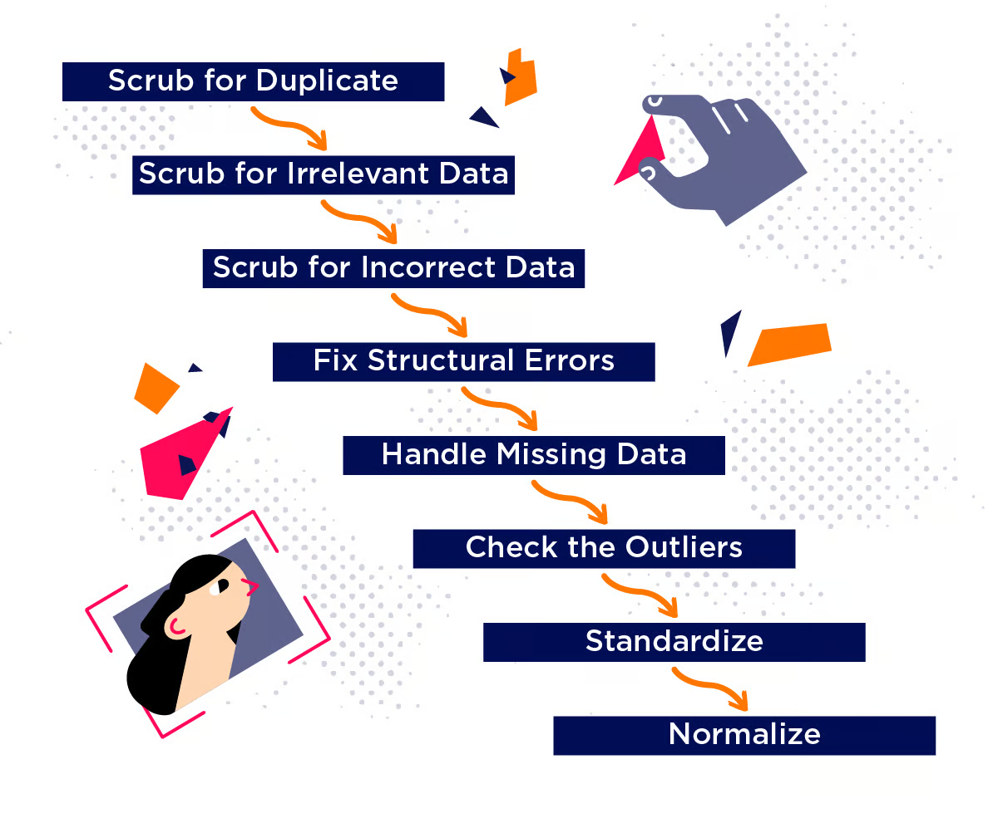
Methodology
Data Cleaning: Addressed inconsistencies such as correcting "mayor" to "major" in the Severity column.
Statistical Analysis: Explored correlations, averages, and trends (e.g., Severity vs. Resolution Time).
Pivot Table Insights: Used to identify trends in ticket volumes, agent performance, and satisfaction metrics.
Visualization: Created line charts and bar graphs to represent temporal trends and distributions.

Slide 5
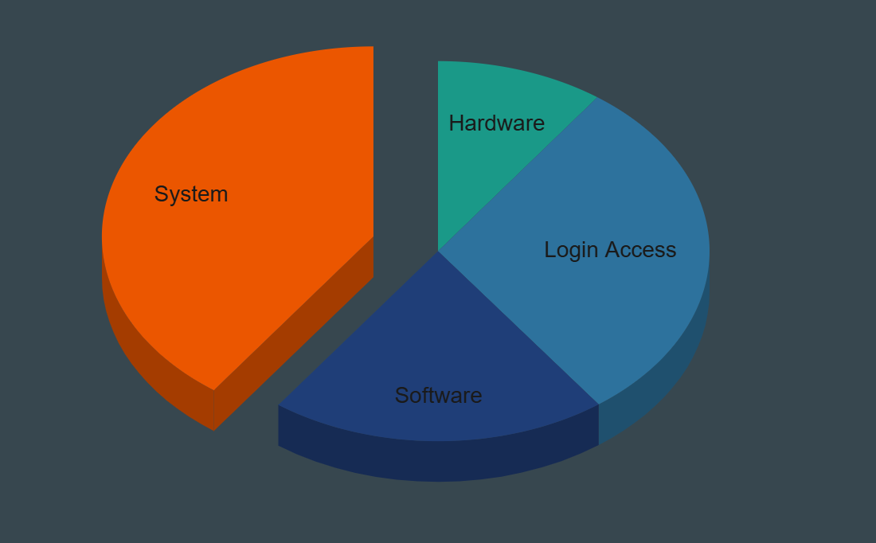
Ticket Categories Distribution
Login Access: 29,193 tickets (30%).
System: 39,002 tickets (40%).
Software: 19,570 tickets (20%).
Hardware: 9,733 tickets (10%).

Slide 6

Agent Performance Analysis
Tickets Handled: Ranges from 1,856 to 2,027 per agent.
Average Agent Age: 35.4 years.
Email Domain Extraction: Used formulas to identify fp20analytics.com as the primary domain.

Slide 7
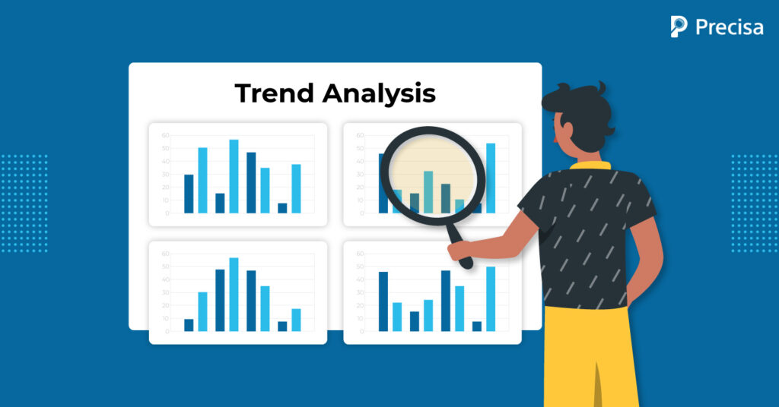
Key Performance Metrics
Correlation (Severity vs. Resolution Time): 0.45, indicating a moderate positive relationship.
Average Resolution Times by Category:
System: 6.62 days.
Hardware: 7.63 days.
Login Access: 0.31 days.
Software: 5.24 days.

Slide 8
Investment Recommendations
Analysis Approach: Conducted a comprehensive cost-benefit analysis by comparing resolution times and satisfaction rates.
Findings:
Average resolution time: 4.5 days.
Satisfaction rate: 4.1 (on a 5-point scale).
Increased staffing is not cost-effective, given consistent metrics over five years.
Recommendation: Focus on improving agent training programs to enhance skill sets and reduce resolution times.
Example: Implement workshops on time management and technical troubleshooting to address common challenges.

Slide 9
Agent Training Needs
Identification of Needs:
Agents with satisfaction scores below 4.0 and resolution times above average were flagged for training.
Example: Agent IDs 38, 39, and 49 had longer resolution times and lower satisfaction rates.
Training Focus Areas:
Enhancing technical knowledge.
Improving time management.
Strengthening communication skills.
Outcome Expectation: Targeted training will lead to higher satisfaction rates and reduced ticket backlogs.

Slide 10
Technology Impact Assessment
Analysis of Tools: Compared performance metrics before and after tool implementation.
Findings:
No significant reduction in resolution times despite increased ticket volume.
Slight improvements in satisfaction suggest that tools are moderately effective but could benefit from optimization.
Recommendations:
Conduct a detailed evaluation of current tools to identify inefficiencies.
Implement incremental upgrades, focusing on automation and integration capabilities.
Example: Deploy AI-driven ticket categorization to streamline the resolution process.

Slide 11

Performance Optimization Strategies
Targeted Training Programs:
Develop role-specific training modules for agents with low performance metrics.
Conduct workshops focusing on technical troubleshooting, communication skills, and time management.
Introduce a mentorship program pairing low-performing agents with experienced ones.
Peak Period Staffing Adjustments:
Analyze historical ticket trends to forecast peak periods.
Reallocate resources to high-demand months (e.g., January to March, June to December).
Offer flexible schedules or temporary staffing during surges.

Slide 12
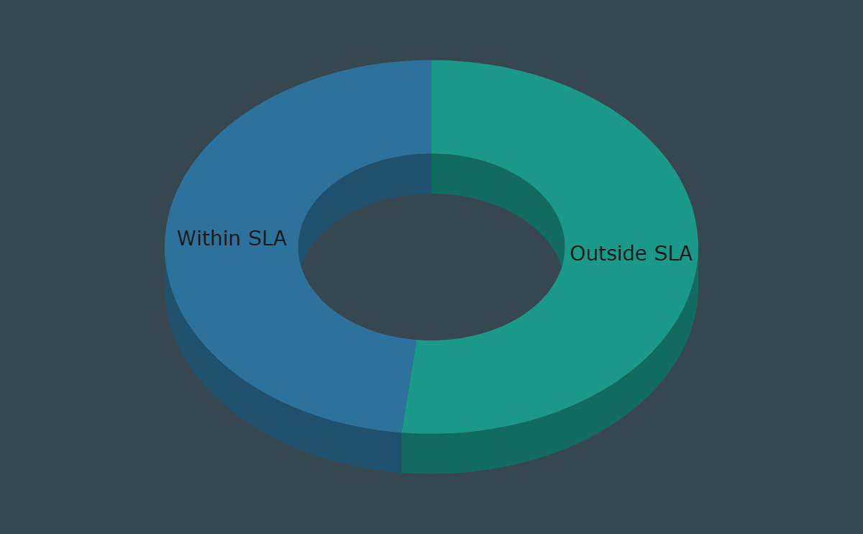
Process Improvements
SLA Adherence Tools:
Implement tracking mechanisms to ensure resolution times align with Service Level Agreements (SLAs).
Use dashboards to alert teams to impending SLA breaches.
Advanced Ticket Categorization:
Use machine learning algorithms to predict ticket severity and category for prioritization.
Integrate automated workflows to route high-priority tickets directly to senior agents.
Feedback Integration:
Conduct bi-annual surveys to capture agent and user feedback on processes and tools.
Use feedback to refine operational policies and enhance user satisfaction.

Slide 13
Technology Strategy
Evaluate Current Tools:
Conduct a thorough audit of existing ticket management systems to identify gaps.
Assess user feedback on tool usability and performance metrics.
Selective Technology Upgrades:
Prioritize upgrades to features that improve ticket routing and resolution speed.
Evaluate the ROI of integrating AI-based solutions for predictive analytics and automation.
Long-Term Tech Strategy:
Plan phased upgrades to avoid operational disruptions.
Include scalability in technology investments to meet future demands.
Agent-Friendly Interfaces:
Ensure new tools are user-friendly and include comprehensive training for smooth adoption.

Slide 14
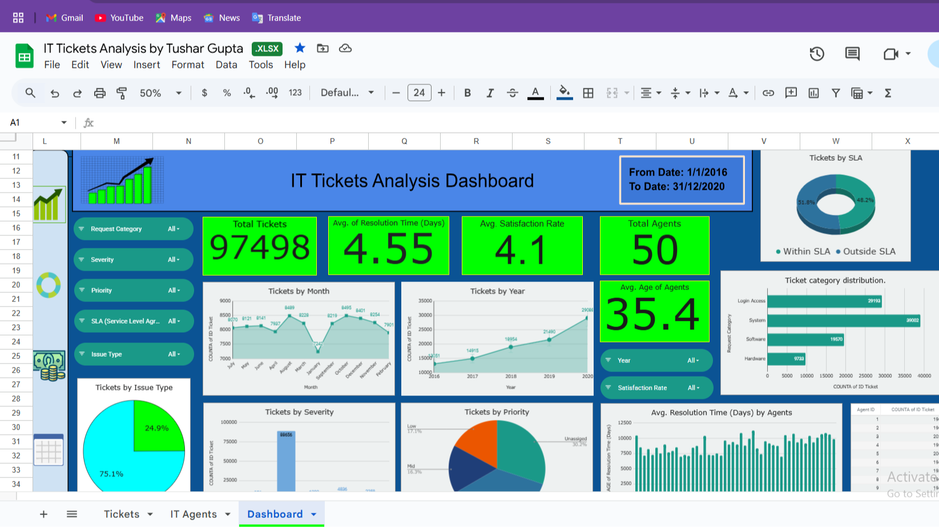
Dashboard and Visualizations

Slide 15

Conclusion
Summary:
Ticket resolution times and satisfaction rates have remained consistent but require enhancements to meet increasing demands.
Training programs are cost-effective and necessary to improve overall efficiency.
Strategic adjustments to staffing and technology are crucial for sustaining operational excellence.
Next Steps:
Implement targeted training programs immediately.
Conduct a comprehensive evaluation of current tools and plan for selective upgrades.
Optimize agent allocation during identified peak periods.

Slide 16

Acknowledgements and References
Acknowledgements:
Data Analysis Team.
IT Support Staff for their operational insights.
fp20analytics.com for domain-related data.
References:
Internal IT ticket dataset.
Statistical tools and pivot table analysis for deriving insights.
Charts and visualizations for trend analysis.

